Slide 1
The MindSlide a Kinaesthetic Visual Analogue Scale
With Maureen Colohan
www.themindslide.co.uk
Tel: 0044-7771846479

Slide 2
The MindSlide
What’s that about?
It’s a kinaesthetic, visual analogue scale (VAS) or in my words something to hold on to.
Some trauma clients seemed to struggle with words.
Reflected on kinaesthetic and the idea of a moving slide was born.
7 years in the making
Looked for validation – Chester University UK
Help me spread the word, bring it into your country and carry out further research.

Slide 3
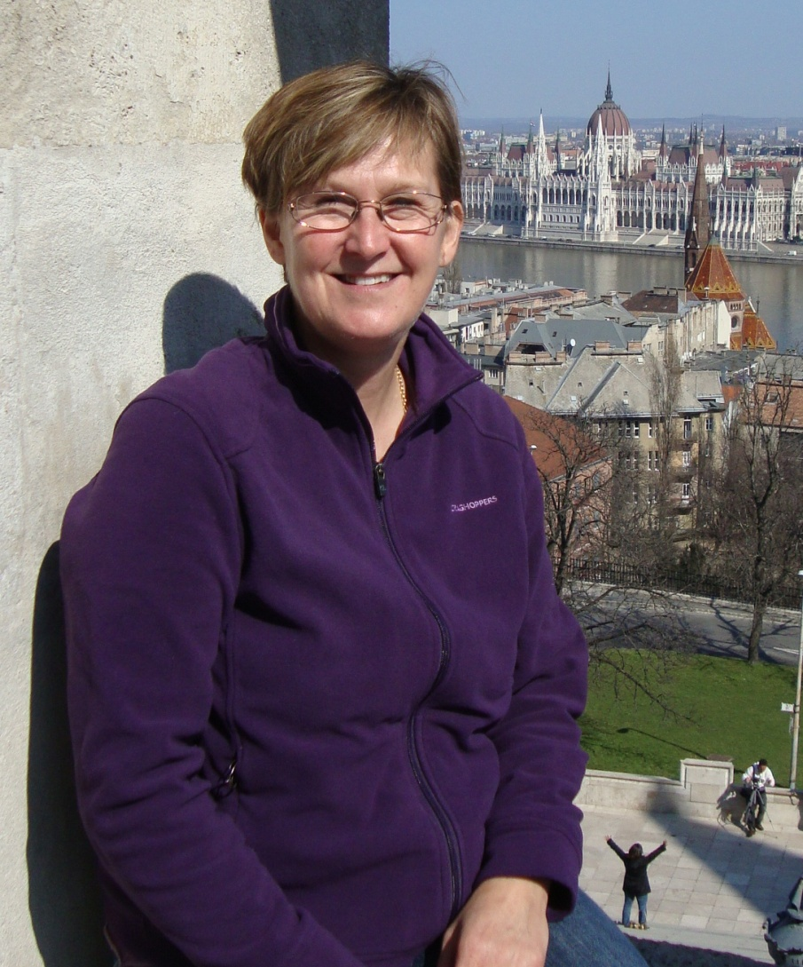
Case Study
Jackie 44 yrs. Old ex military.
Husband killed in a freak accident, no kids.
Four years on has developed a panic disorder about leaving the house.
Video link

Slide 4
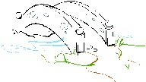
What does it do?
thinking
feelings
Feedback says
It’s like a bridge between internal and external worlds
It helps create an external focus for pause and reflection.
It adds movement to internal processing and validates change
It offers a solution focus

Slide 5
Chester University
Questions for the MindSlide?
Do VAS measure the judgment of the feeling state OR the judgement of the experience of the feeling state (body sensations)?
If the later can this be assisted by the use of a tangible VAS like the MindSlide either as an adjunct to graphic scale or independently ?
The reliability of the VAS is influenced by the intensity of the sensation being experienced, could The MindSlide improve reliability and validity of VAS?
Can the experience of change and discrete difference be facilitated kinaesthetically (and made more reliable) by physical movement along the measurement scale?
Can the MindSlide assist with defining cardinal states?
Could the requirement of ascension to judgement of the experience of the feeling and to body sensations rather than just the feeling have therapeutic benefit?

Slide 6
Conclusion
The small study showed that The MindSlide can be accepted as a therapeutic and assessment tool in two diverse settings and across the child and adult age range.
Both versions of the scale were found to be helpful and the general concept of a handheld scale was regarded positively in terms of engagement, containment and maintaining focus on the ‘here and now’ experience and differentials of experience.
A number of design improvements were suggested.
Download the full report at www.themindslide.co.uk

Slide 7
Want to work together?
I am looking for help to spread the word!
Do you want to work with me to bring The MindSlide into your country
Are you interested in further research
Contact me email
maureen@themindslide.co.uk

